Slide 1
Internship Topic-Smart meter
Location-Lucknow Uttar Pradesh
Name-Rajeev Singh
USN-1RV21EI039

Slide 2
Name of Project-Advanced metering infrastructure (AMI)-Smart meter
1. Technical EESL architecture of AMI solution
Head End System (HES)
Meter Data Management System (MDMS)
Meter Installation and Consumer Indexing Application
Mobile Application Web Portal for consumers
WFMS Application (Work Force Management System)
SMART METER:
A smart meter is a device that digitally measures and records electricity consumption in real-time. It enables two-way communication between the meter and the utility company, providing accurate data on energy usage and allowing for more efficient management of electricity distribution. Smart meters can also enable features like time-of-use billing and remote connection/disconnection of service

Slide 3
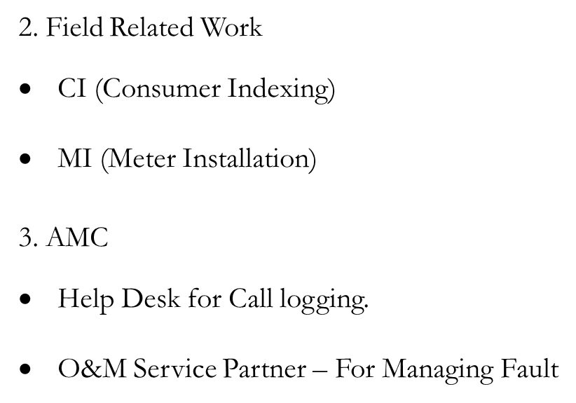
(Annual maintenance contract)

Slide 4
Project Snapshot:
This project for EESL AMI solution comprises of Design, Supply, Installation, Integration, Commissioning, Operation, and Maintenance/FMS Support of Advanced Metering Infrastructure (AMI) Solution for 5-million Smart Electricity Meters in Uttar Pradesh with GPRS-based Communication Module for Haryana and Uttar Pradesh including 03 years of I&C and 05 years of comprehensive AMC of hardware/software. Hence, some of the priority focus areas are increasing billing efficiency and increase in customer satisfaction. To meet this objective, Energy Efficiency Services Limited (EESL) has decided to undertake this activity in two parts:
i. Supply of Smart meters with GPRS-compatible NIC cards.
Installation, testing, commissioning, and integration of the AMI system.

Slide 5
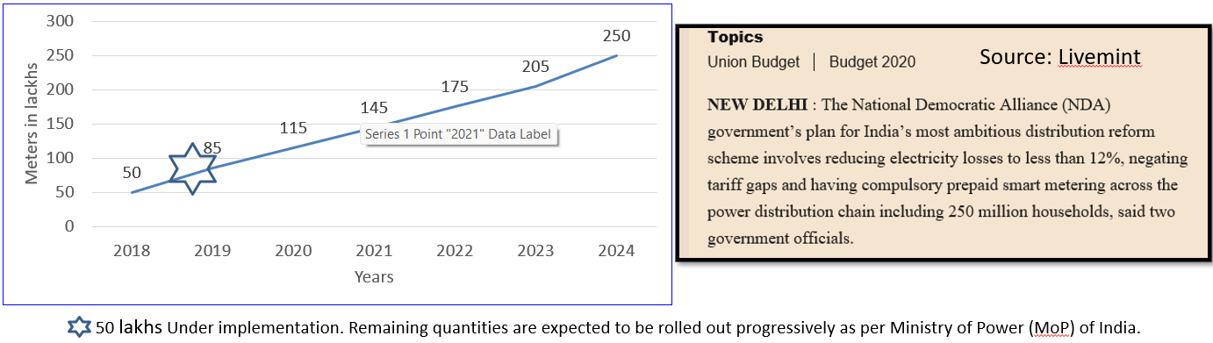
Project objective: Implementation of Smart meter objective by Discoms
Increase in Discom revenues
Increase in Billing efficiency
Reduction in commercial losses
Increase in Customer Satisfaction

Slide 6
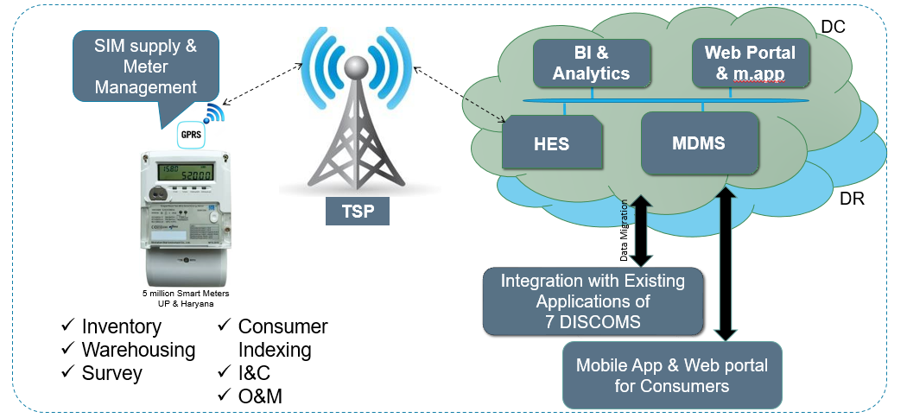
High- level AMI system architecture

Slide 7
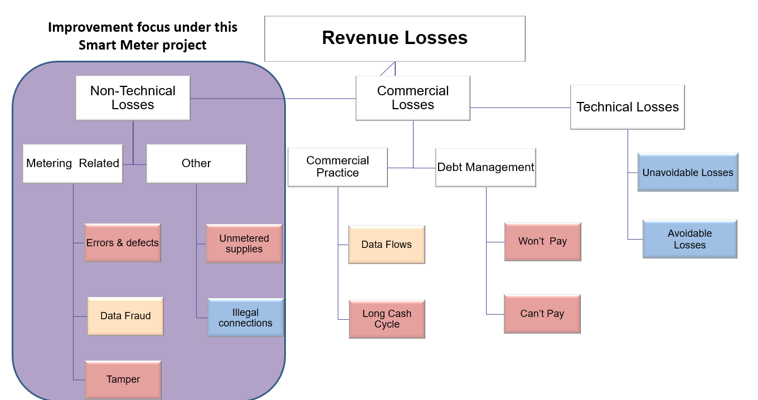

Slide 8
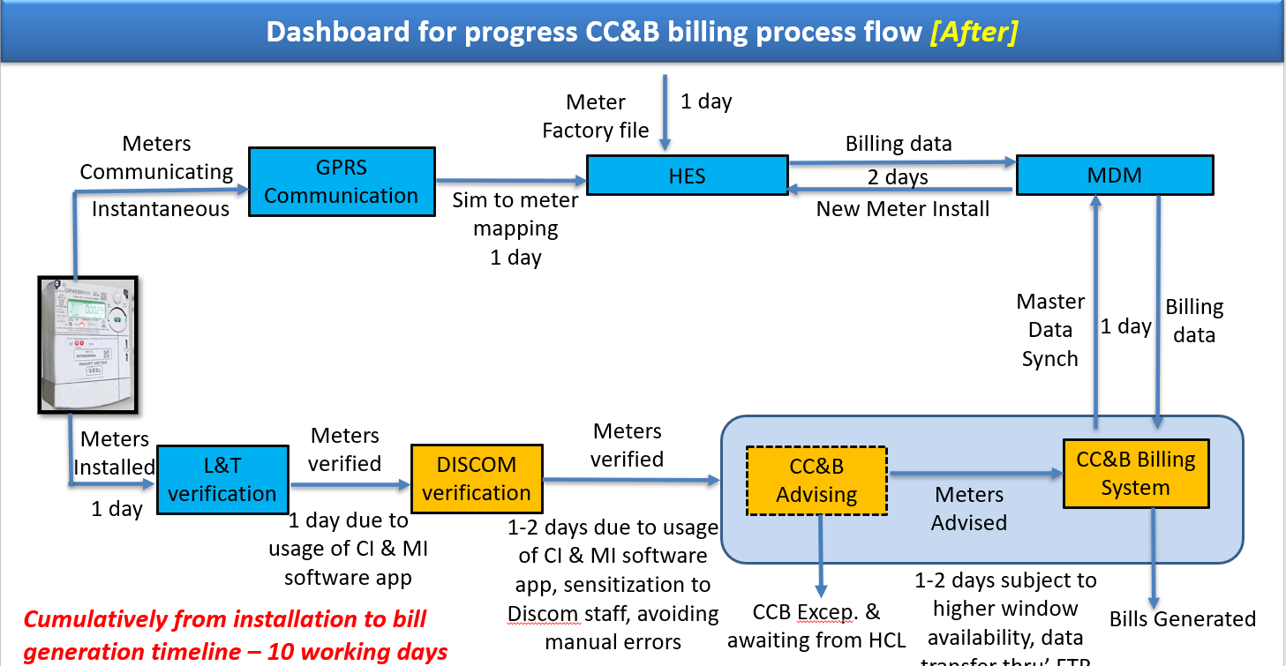
GPRS-General purpose Radio services
CC &B-Consumer care and Billing
DISCOM-(Distributing companies of electricity): Their responsibility is to distribute Electricity to the consumers.

Slide 9
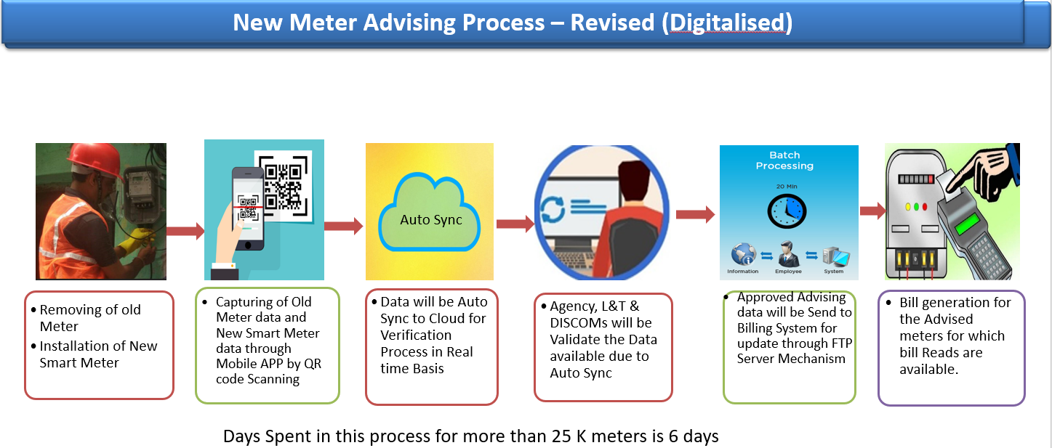
FTP-(File Transfer protocol)- is a way to download,upload, and transfer files from one location to another location on the internet and between computer systems.

Slide 10
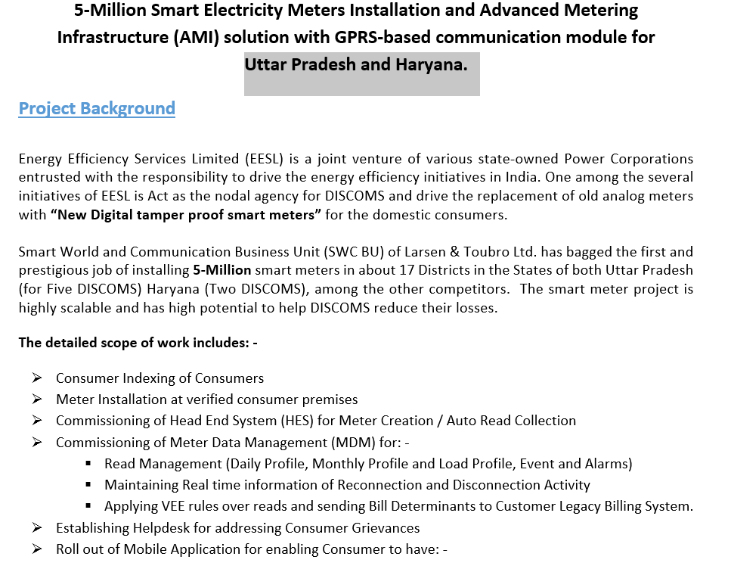

Slide 11
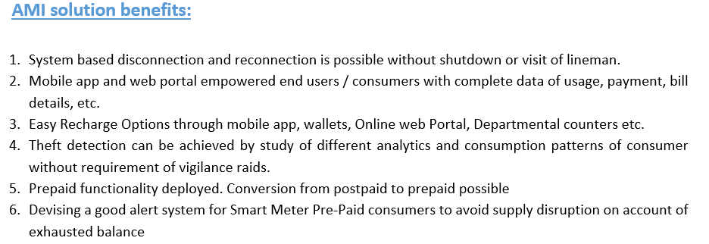

Slide 12
.CONSUMER INDEXING
Consumer Indexing is the process of capturing Network/Admin hierarchy and Meter information of live consumers. In this process master data (i.e. details of consumers like consumer name, account number, consumer address, etc.) is provided by DISCOM aftermath same is uploaded to MI Database. Once the data is uploaded successfully to the MI database it is assigned to a particular Field Technician for verification and correction required.
2.1.1 Verification Stages
Status (As per MI) | Responsibility | Remarks
CI Completed | Sub-Contractor | CI Completed by Agency
CI SC Approved | Sub-Contractor | CI Approved by Agency
CI L&T approved | L&T | CI Approved by L&T
CI DISCOM Approved | DISCOM | CI approved by DISCOM

Slide 13
.Meter Installation: (D1)
The meter is to be installed by the Field team after completion of Consumer Indexing, All the details (Old Electronic Meter Pictures, Smart Meter pictures, Sealing Certificate Pictures) need to be captured and uploaded in the MI database using Meter Installation App. During Meter installation, a few measures are to be taken adopted in terms of meter communication status and errors being displayed in the meter.
.Meter Communication Status:
During Meter Installation precautions regarding meter communication status (RSSI should be >15) should be considered. Areas having low coverage signals need to be avoided for installation and the same should be communicated with TSP for enhancement of signal in the vicinity. TSP is being managed by Voda for the establishment of GPRS communication in Smart Meter. Vodafone delivers a communication establishment based on a solution SIM that can be installed in the Smart Meter modem device and used across the identified territory.
Meter Error:
The meter displays a set of Errors starting from Error 00 – To error 12 which indicates various parameters about the meter SIM. Hence, It is advisable to install the meter on Error 0 and Error 10 only.
S. No. | Error on Meter Display | Error Description
1 | Err 00 | All Good
2 | Err 01 | Meter NIC communication failure
3 | Err 02 | Modem Initialization failure
4 | Err 03 | SIM not detected
5 | Err 04 | SIM invalid
6 | Err 05 | No GSM Network Coverage
7 | Err 06 | GPRS Network Registration failure
8 | Err 07 | GPRS Registration denied
9 | Err 08 | No APN configured
10 | Err 09 | GPRS connection not established
11 | Err 10 | HES IP/Port not configured
12 | Err 11 | HES port not open
13 | Err 12 | Any Key mismatch b/w Meter and NIC

Slide 14
.Advising in CC&B:
Advising is the process of attaching a Smart Meter in CC&B (Consumer Care and Billing System) with consumer Id for further billing process. The purpose of advising is to facilitate the billing data to the CC&B system. UPPCL has an older version of Oracle CC&B (v2.3.1) implemented. Since the meters will be replaced in bulk, there is a need to have an automated way to replace the meters in the CC&B system. This process called in UP as Meter Advising explains the way the meters will be replaced in the CC&B system.
.Master Data Synch in MDM
Once the smart meters are advised in UPPCL’s CC&B system, the data needs to be synced with the MDM system via Oracle provided CCB – MDM integration pack. Master Data Synch is used to configure consumer details in Master Data Management System which makes a bridge between HES and CC&B. The Meter Data Management System support storage, archiving, retrieval & analysis of meter data and various other MIS along with validation & verification algorithms. MDMS shall also support the future requirement of DISCOM and shall support the integration of other smart grid functionalities like Distribution Transformer Health Monitoring system, self-healing system, etc. as and when implemented by the DISCOM.

Slide 15
HES Meter Registration :
The main objective of HES is to acquire meter data automatically avoiding any human intervention and monitoring parameters acquired from meters. Head End System is being managed by Trilliant, HES plays a crucial role in fetching data from Meter. Meters need to be registered and commissioned in HES for further communication and data fetching. (*Trilliant is a global provider of secure, enterprise-wide smart energy communications solutions).
Meter Commissioning :
Meter commissioning is the process, where HES communicates with the meter and verifies its configuration (such as meter-ipv6 address mapping). Once the meter is commissioned in HES its status changes from installed to commissioned.
.GPRS: It is a packet-oriented wireless mobile data service on the 2G and 3G cellular communication systems. It is a non-voice, high-speed packet-switching technology intended for GSM networks. GPRS supports Internet Protocol (IP) and Point-to-Point Protocol (PPP). General Packet Radio Service (GPRS) was one of the most popular data access models in Asia and Europe. Later it was adopted by some of the carrier network giants like Rogers and Tmobile in Canada and the USA. With the advancement of technology, faster versions of 3G and 4G were introduced.

Slide 16
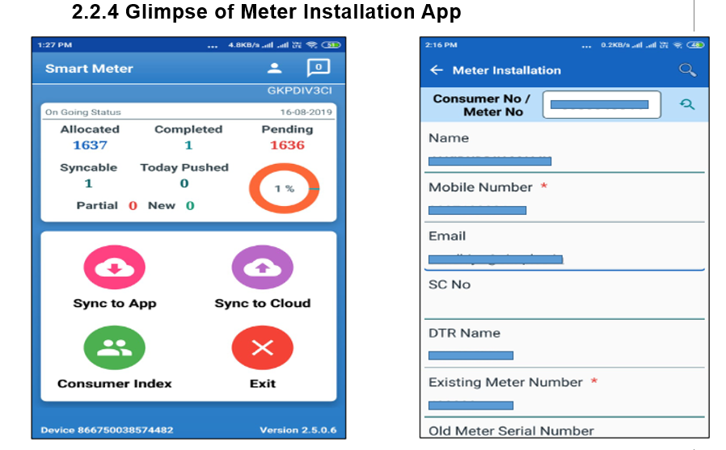

Slide 17
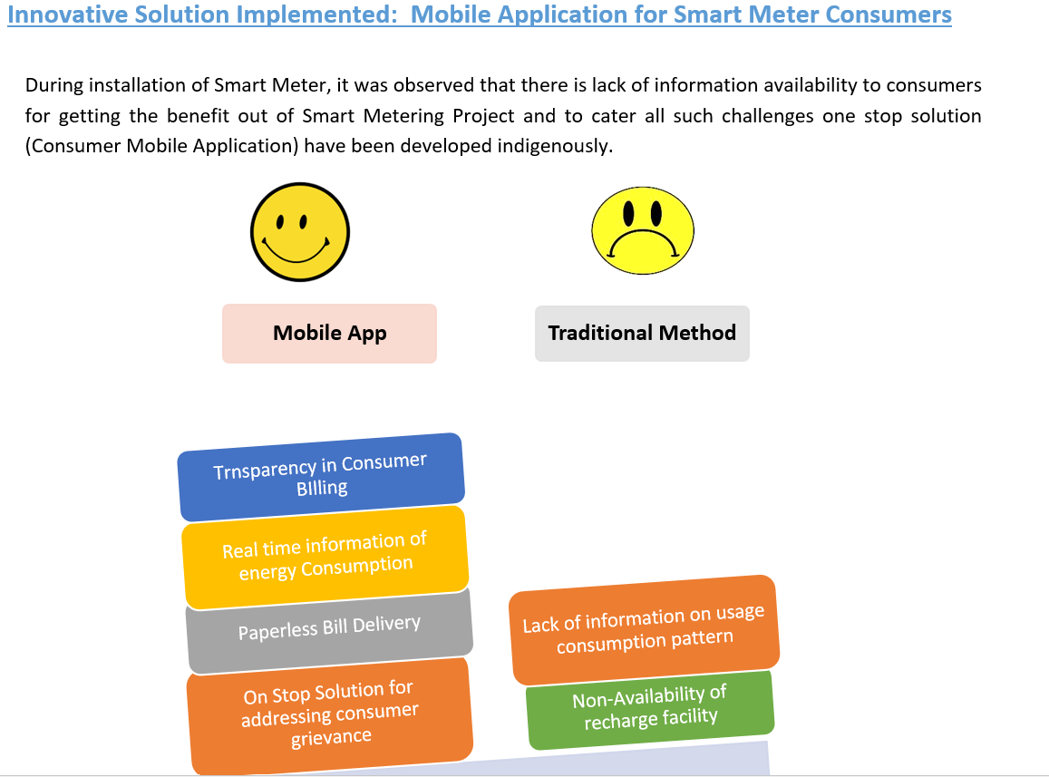

Slide 18
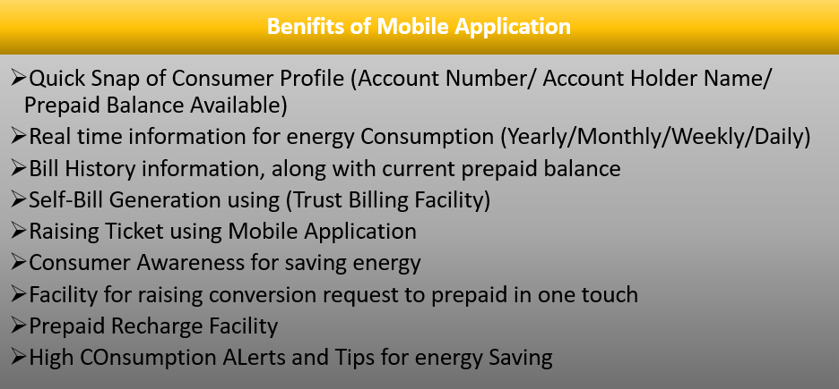

Slide 19
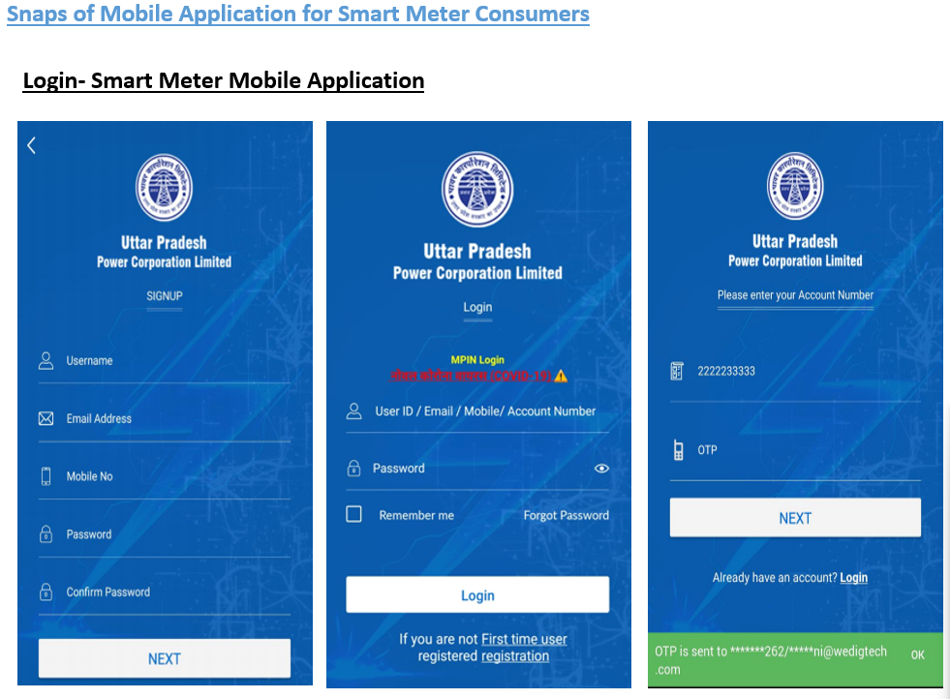

Slide 20
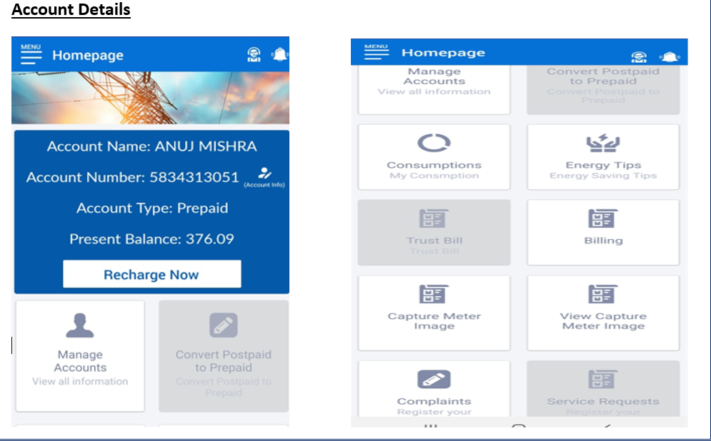

Slide 21
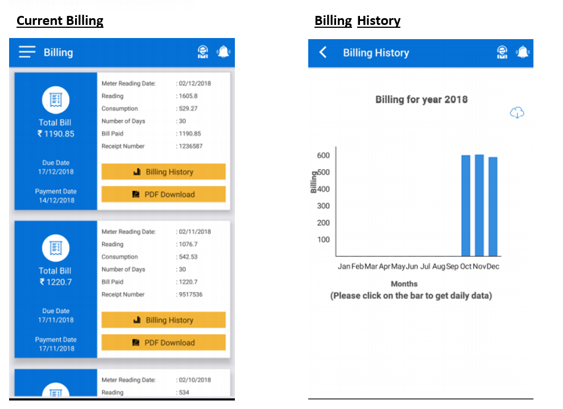

Slide 22
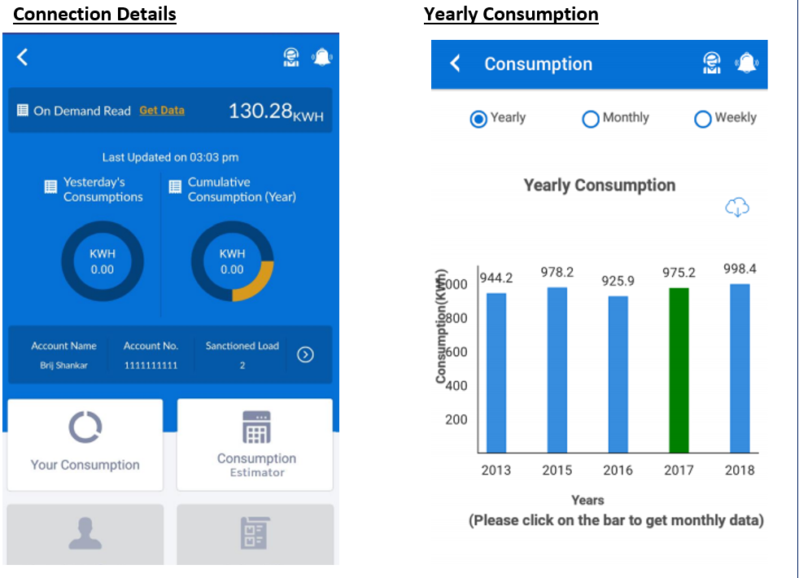

Slide 23
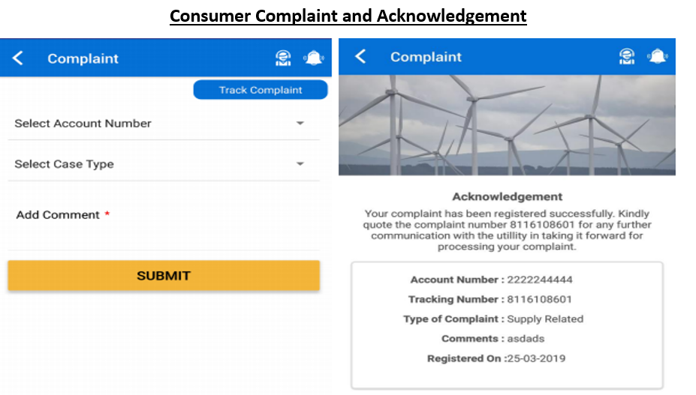

Slide 24
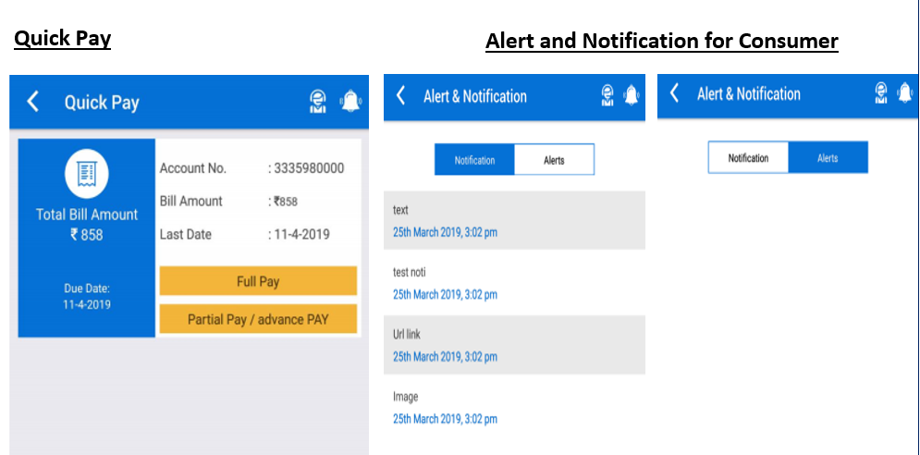
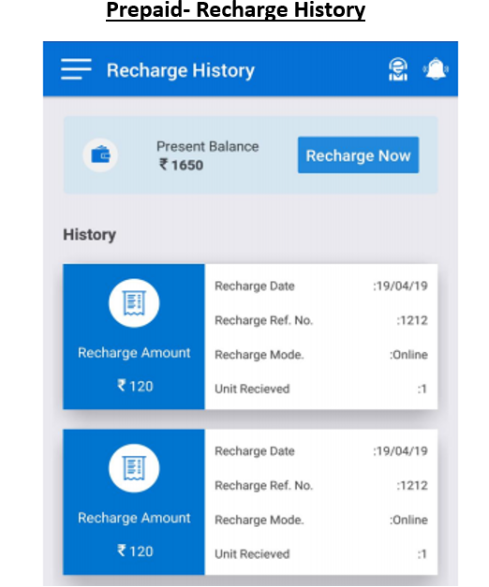

Slide 25
Difference between Analog and Smart meter
Analog meter
Smart meter
One Way communication
Not connected to the Internet
Loss of revenue is more
Bill payment is done after the end of the month
Consumers can check on their consumption only at the end of a billing cycle.
Two Way communication
Connected to the Internet
Loss of revenue is less
Bill payment has to be done at the start of a billing cycle
Consumers can have check on their daily consumption.

Slide 26
MY QUESTIONS AND ANSWERS REGARDING THIS INTERNSHIP
Q.1-Why smart meters are generally fitted outside our houses?
Ans.1-Because to get good network coverage as the smart meter has a sim installed in it which requires a good signal for two-way communications and also for protecting consumers from Radiofrequency(RF) which is emitted by smart meters.
Q.2-What is TDP(Thermal Design Power)?
Thermal Design Power (TDP), sometimes called Thermal Design Point, is a metric that is expressed in watts. TDP refers to the amount of power/heat a cooling system (like a fan, or heatsink) is expected to dissipate to prevent overheating.

Slide 27
Q.3-How smart meters are helpful in reducing revenue loss and increasing DISCOMs revenue?
Ans.3-These are the following features of the Smart meter which are responsible for the reduction in revenue loss and increase in DISCOMs revenue-
i-Improved billing efficiency
ii- Automatic theft detection system
iii-Automatic disconnection of defaulters without any field visit.
Q.4-What is RSSI?
Ans. 9: Received signal strength indication (RSSI) measures the strength of a radio signal that has been received. For a user of receiving equipment, RSSI is frequently invisible. But since wireless networking capability can be significantly affected by signal strength variations, devices frequently make the measurement available to users. RSSI should be greater than 15 for the Smart meter to function properly.

Slide 28
Q.5- Are smart meters safe?
Ans.5- If you look closely at a smart meter, you'll see it has a CE mark, which means they meet the European Union's safety standards.
While there are rumors circulating that smart meters emit dangerous amounts of radiation, they actually send out far less than the mobile phone you keep in your pocket or the microwave you heat your food in.
Public Health England (PHE), a government watchdog, has confirmed that smart meters cause no risk to your health and aren't dangerous to have in your home.
Q.6-Does having a smart meter mean my energy bills will increase? Ans-You should be aware of how much energy you're using if you have a smart meter so you may aim to be more efficient. Additionally, it signals the end of projected billing, making your bills more precise. If your energy provider underestimated the amount of energy your household uses, this may result in an increase in your direct debits. On the other hand, if you turn out to be more energy-efficient than anticipated, your bills may be reduced. We recently conducted an online survey, and the results showed that 34% of smart meter owners believed their gas and electricity use had decreased after installing a smart meter.20%, however, believed that their energy consumption had grown.

Slide 29
Q.7-What are the pros and cons of smart meters?
Ans.7-Pros:
Your in-home display will show you a clear picture of your energy use and spending to help you understand it better.
You can watch how your activities directly impact your energy bill – for example if you’re home all of Sunday when you cook a full roast, put the kettle on a lot, and do the ironing versus a day when you're mostly out.
This can help you save money as seeing an almost real-time spend can be more confronting than a bill at the end of the month.
And because smart meters automatically send your energy usage to your supplier, you'll have more accurate bills and will be less likely to get a painful sudden increase to your direct debit.
Some energy suppliers also only offer some of their tariffs to people with smart meters.
Cons:
A smart meter may become "dumb" when you move suppliers, meaning it won't automatically communicate your usage back to your provider, even though you are still able to change suppliers. Depending on the kind of smart meter you have and the business you transfer to, this will happen. About 70% of SMETS1 devices, according to the National Audit Office, stopped working when individuals switched. The BEIS informed us that 90% of smart meters are still fully operational.

Slide 30
Q.8- Can I control what data is shared about me?
Ans.8- You have control over how your energy data is utilized, in addition to how it is used to charge you for your consumption. Energy providers may see your daily data unless you object. Access to anything other than monthly data, which can only be used to fulfill their statutory obligations, requires consumer consent or Ofgem authorization. In addition, you can grant access to your energy consumption data to energy providers and other third parties for marketing purposes. For instance, after 2020, switching sites might inform you about better rates that are available to you. But before they can do anything, they must get your approval.
Q.9- As a renter, can I get a smart meter if my landlord doesn't want it?
Ans.9- It is entirely up to you, not your landlord, if you pay the bills and manage the energy account, whether you get a smart meter. Even though you pay the bills, you should always review your rental agreement in case there are limitations on the sort of meter you can install.

Slide 31
-What other things I have learned through this internship?
.Team Work
.Leadership
. In-office discipline
. Decision-making ability
.Regularity and Punctuality
. Problem-solving techniques
.Time management
.Communication skill
.Sense of Professionalism

